Slide 1
Writing Your
Game’s Rules
With some help from the game Splendor and others

Slide 2
Games are rules.
Rules are games.
Yes? No? Explain.

Slide 3
Game designers create rules.
Good games have complete rules.

Slide 4
Writing rules is another way to develop your prototype.
Writing rules helps define your game.

Slide 5
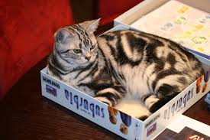

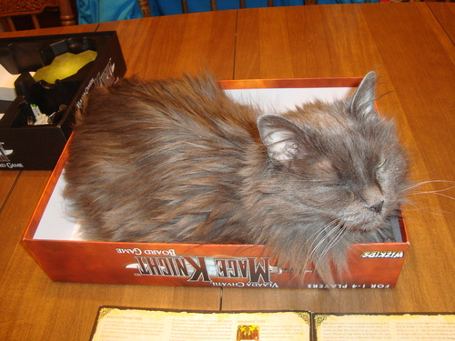
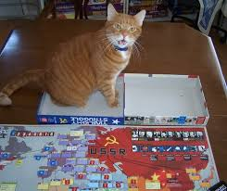

You Don’t Come in the Box!
You have to write a rule book that explains what players have to do with hopefully no questions.

Slide 6
Two Purposes for Rules
Help new players learn how to play the game
Gives an overview and flow of the game before the specifics
Act as a reference for experienced players
Comprehensive and complete to have no unanswered questions regarding the rules
Uses subheadings to help players find information.

Slide 7
The Four* C’s of Good Rules
Clear
Consistent
Concise
Complete

Slide 8
The Four* C’s of Good Rules
Clear: The goals and decisions players may make, using the game’s resources, are clear.
There is a difference between may, must, can, etc.
“Last” may mean “previous” or “final.”
Either could mean “one or the other” or “both.”
Be sure to choose your words carefully. Life lesson.

Slide 9
The Four* C’s of Good Rules
Consistent: Use the same structure and terminology throughout the rules.
Terminology needs to be consistent.
Using two different terms for the same thing, or the same term for different things, is bound to cause confusion -- don't do that!
Define your terms at the beginning, and stick with them.

Slide 10
The Four* C’s of Good Rules
Concise: Write bluntly and directly. Be specific.
When writing rules you have to be a straightforward and clear.
The reader must understand exactly what you are talking about without question.
There is no room for interpretation in rules so word choice must be assertive as to remove all doubt.
Use second person, imperative sentences.
*from Brett J. Gilbert’s 5 C’s of Good Rules

Slide 11
The Four* C’s of Good Rules
Complete: The written rule set contains all of the game’s rules.
Record yourself teaching the rules, then use that recording to help you write your first draft.
Think about what information players need to know--you have to put yourself in their shoes.
*from Brett J. Gilbert’s 5 C’s of Good Rules

Slide 12
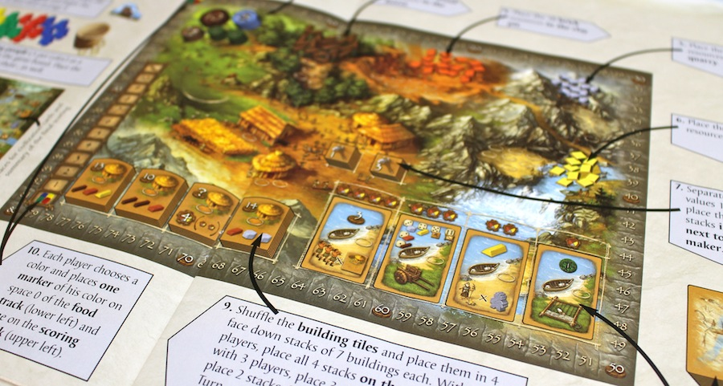
Complete: Use Diagrams!

Slide 13

I Beg Thee
Don’t assume
players will understand what you mean or need them to do!

Slide 14
Essential Game Rule Elements
With help from Splendor

Slide 15

Title
What are you going to call the game that attracts attention and conveys the theme of the game?

Slide 16

Story
A paragraph or so long story that provides a context for the game to get players excited and to provide an overall perspective on the game.

Slide 17
Player Objectives
Explain the role players are taking on.
Explain what players will do during the game. This should cover the main actions and events of the game.
Explain how the player wins in general.

Slide 18
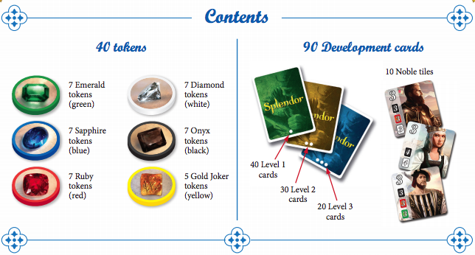
Components
A list of exact quantities of all types of game bits.

Slide 19
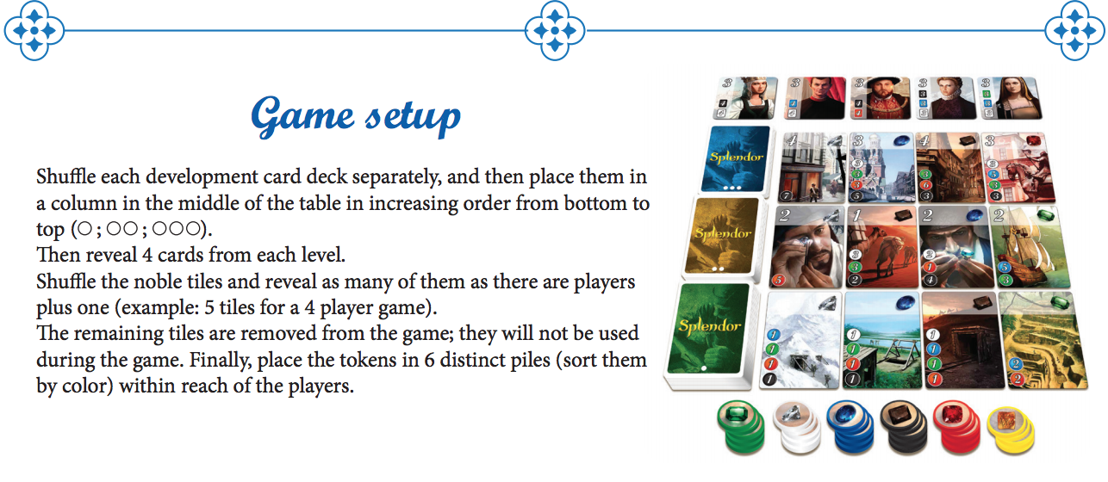
Setup
How to get the game ready for play, explained clearly with diagrams or pictures.

Slide 20
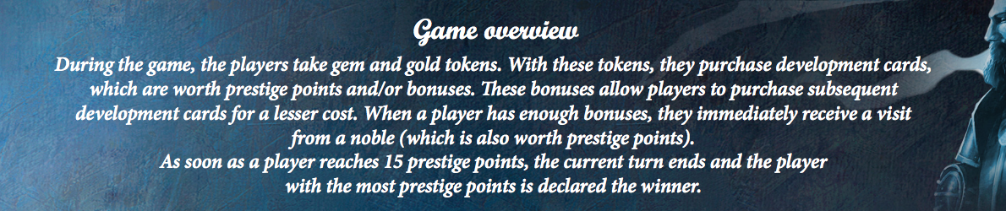
Game Play Overview
The game play overview explains the flow of gameplay
(rounds, turns, phases, etc.) and
summarizes what players do in each of those stages
from start to completion.

Slide 21
Game In Depth
Explain exactly what happens during each turn, action, round, etc., in a logical way.
You also should have sections dedicated to complicated subjects and their edge cases if necessary.
Pictures and examples are essential.

Slide 22
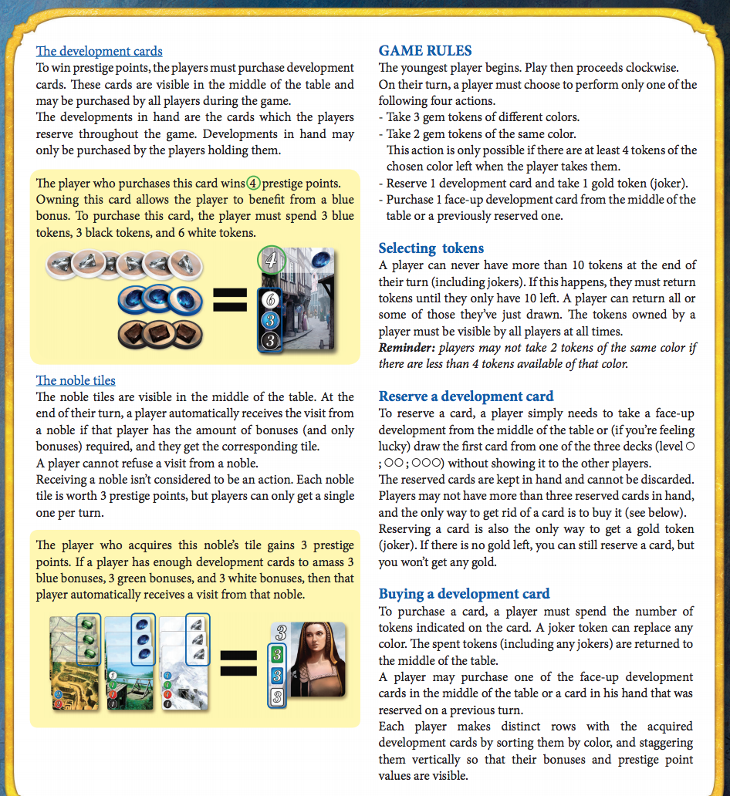
Game Play in Depth

Slide 23
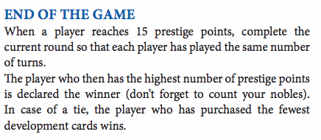
End Game Conditions
End Game Conditions explains
how the game ends
AND
how a winner is determined
AND
A tiebreaker.

Slide 24
Formatting and Writing Game Rules

Slide 25
Writing for Others
In creating a game, often the most difficult part is to write rules that are clearly understood by players.
If players don’t understand the rules, they can’t play the game.
The rules are for the players’ benefit, not yours.
YOU HAVE TO THINK HOW OTHER PEOPLE
MIGHT INTERPRET YOUR RULES.

Slide 26
General Writing Guidelines
Your formatting consistency is going to assist in players understanding what you’re talking about in addition to making your rulebook easier to read.
Group things together (or put things near each other) that are connected to one another.

Slide 27
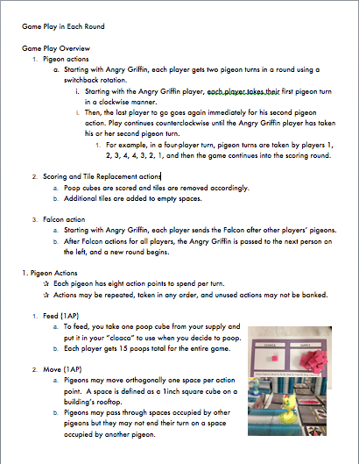
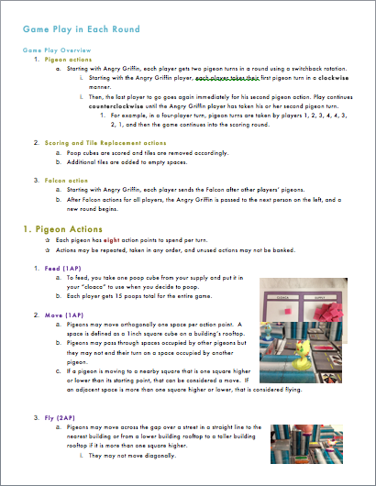

Slide 28
Writing as an Outline
Clearly describe all elements of the game
sequentially (in order)
logically (organized well)
pictorially (using pictures and diagrams)

Slide 29
Writing as an Outline
Be specific, step by step. Write in outline form.
Use larger font sizes to emphasize headings and subheadings.
Use color to make different elements stand out.
Use white space and lists to organize the rules, so that related rules are close together on the page.
Bullet points help clarify where one idea starts and another ends, and which ones are subsets of others.
Keep items of similar importance at the same level.
Put lesser items at a lower level.

Slide 30
Write in Second Person
You should be writing as if you’re speaking directly to the reader; using terms like “you” and “your” instead of “a player” or “their”.
It makes the rules more personal and assists in reader comprehension and retention.
If players actually see themselves playing the game when reading the rules, they’ll be more interested and involved in reading them.

Slide 31
Write in Second Person
Do Say | Don’t Say
“When you…” | “When a player…” or “The player…”
“give each player…” | “each player takes…”
“On your turn, choose…” | “On his or her turn, the active player chooses…”

Slide 32
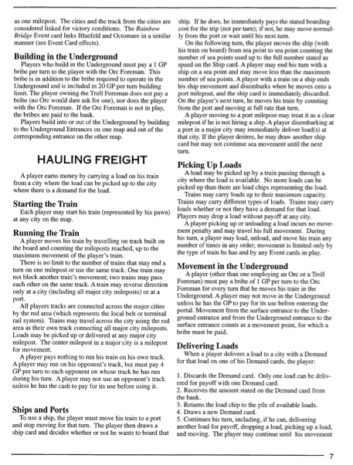

Slide 33
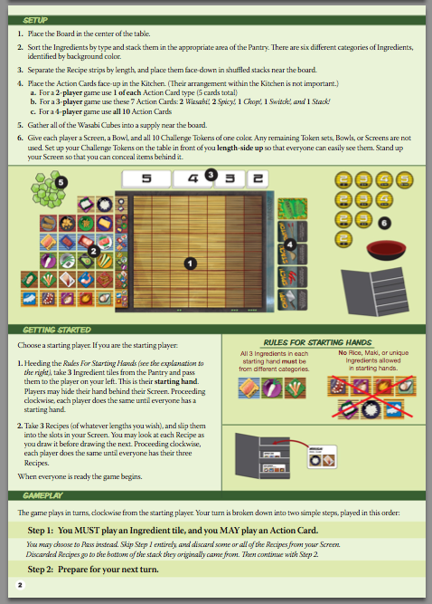

Slide 34
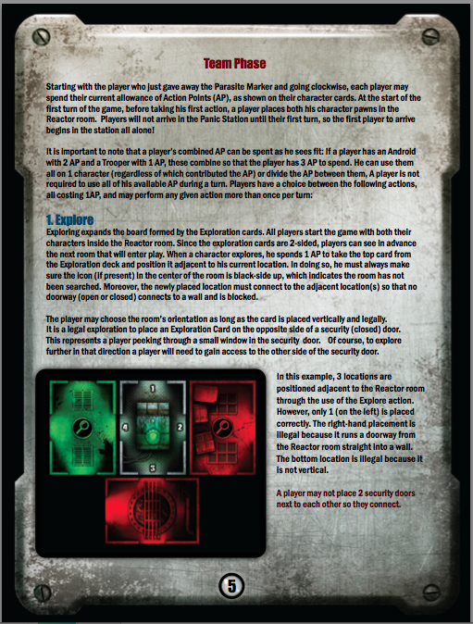

Slide 35
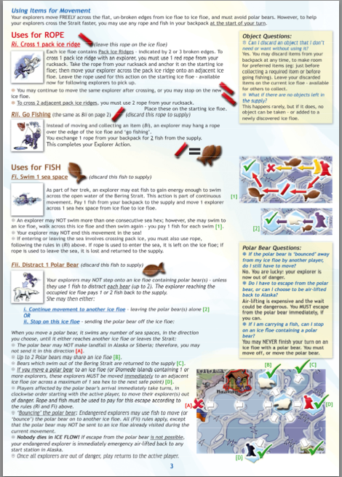

Slide 36
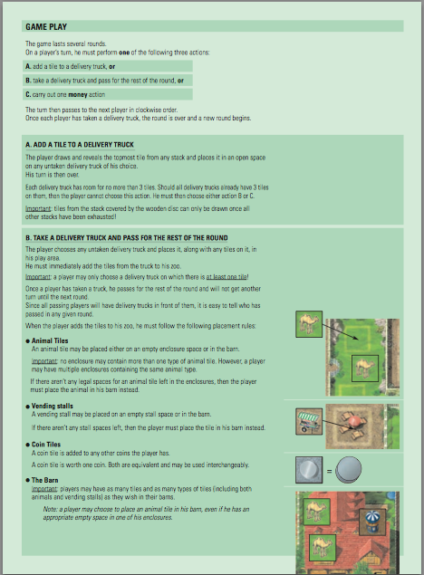

Slide 37
Any Questions?

Slide 38
Let’s Get Started!
Get a laptop, log on
Go to my Ladue website
Go to Engineering Strategy Games
Click “Blank Rules Game Template”
Make a copy, rename it, share it back to me

Slide 39
Assignment
Get out a game you’ve played, but not read the rules.
Read the rules.
Write down five examples of good rule writing--the four C’s, not formatting!
Clarity: The goals and decisions players may make, using the game’s resources, are clear.
Consistency: Use the same structure and terminology throughout the rules.
Concise: Write bluntly and directly. Be specific.
Complete: The written ruleset contains all of the game’s rules.

